Slide 1


CMPE 135: Object-Oriented Analysis and Design October 10 Class Meeting
Department of Computer Engineering San Jose State University Fall 2017 Instructor: Ron Mak
www.cs.sjsu.edu/~mak

Slide 2
Midterm Review
We looked at code that was functional but was inflexible and hard to maintain.
Code that was not able to handle change.
We incrementally improved the code.
In the process, we applied good object-oriented design principles.

Slide 3
Midterm Review, cont’d
Understand what your customer wants.
Functional and nonfunctional requirements.
UML diagrams: Use case, sequence, class.
Analysis
Where do classes come from?
Textual analysis
CRC cards (Class Responsibility Collaboration)

Slide 4
Midterm Review, cont’d
Object-oriented design basics
Abstraction
Encapsulation
Polymorphism
Object-oriented design principles
Encapsulate what varies.
Favor composition over inheritance.
Program to interfaces, not implementations.

Slide 5
Midterm Review, cont’d
Interfaces
Law of Demeter (“Principle of Least Knowledge”
Liskov Substitution Principle
Programming by contract
Precondition
Postcondition
Invariant
SimUDuck simulation game

Slide 6
Bonus Lecture!
Processing Scientific Data: Four Case Studies
Collaborative Information Portal
NASA Mars Exploration Rovers Mission
Systems Health Information Portal
NASA Space Station and Crewed Space Vehicles
National Ignition Facility (NIF)
Lawrence Livermore National Laboratory
Smarter Planet Platform for the Analysis and Simulation of Health (SPLASH)
IBM Almaden Research Center

Slide 7
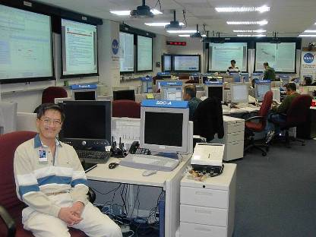


Case Study 1: The Collaborative Information Portal
The Collaborative Information Portal (CIP) was a key ground-based application used by the NASA’s Mars Exploration Rovers (MER) mission.
Mission scientists, engineers, and researchers at JPL and around the world used CIP to access mission data in a secure and organized manner over the Internet.
My role: Senior Scientist Research Institute for Advanced Computer Science (RIACS)
Architect and lead developer of the CIP middleware, 2002-2003
Mission support at the NASA Ames Research Center and JPL, 2004
Mission Control Center, JPL Mars Exploration Rovers Mission

Slide 8
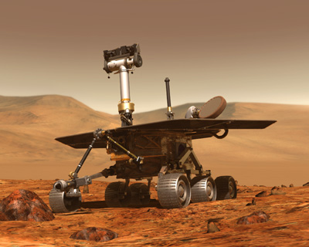
Mars Exploration Rover Mission
Twin robot geologists search for liquid water on Mars in the past.
Launched: June 10 and July 7, 2003
Landed: January 3 and 24, 2004
Duration: 90 days
But after over nearly 10
years, one of the rovers
is still operating on Mars
and continues to send
back data and images.
Mission Center: Jet Propulsion Laboratory Pasadena, CA

Slide 9
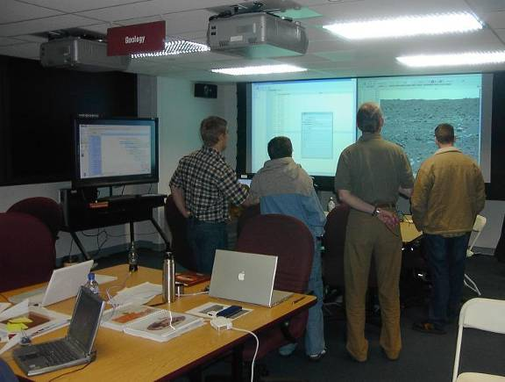
MER Mission Requirements
Time management
Data management
Personnel management
Mission Geology Lab, JPL

Slide 10
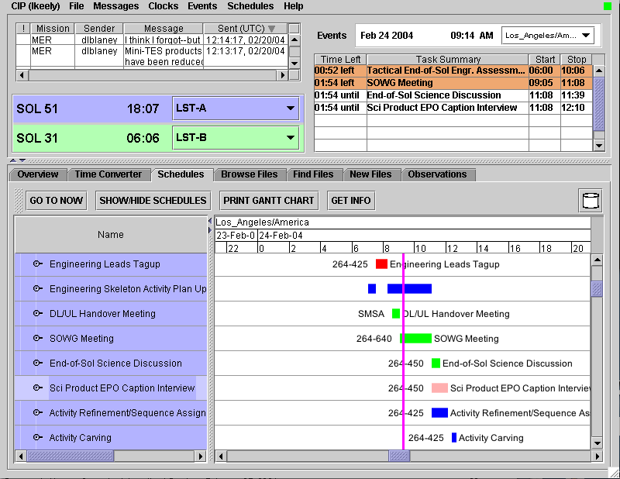
The Collaborative Information Portal (CIP)
Broadcast messages
Clocks
Event horizon
Tool tabs
Schedule viewer

Slide 11
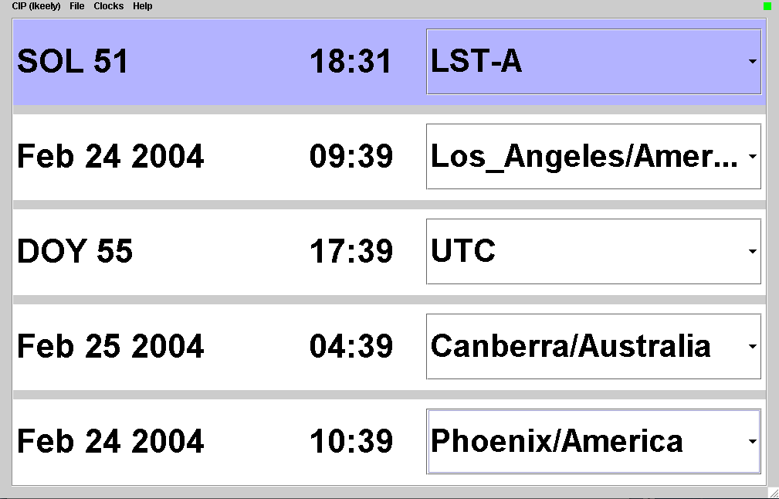
Clocks
Tick-over at top-of-minute
Mars time
displayed
in Sols
Local time
UTC shown in Day of Year
Time at DSN location
Time at
collaborator’s
location

Slide 12
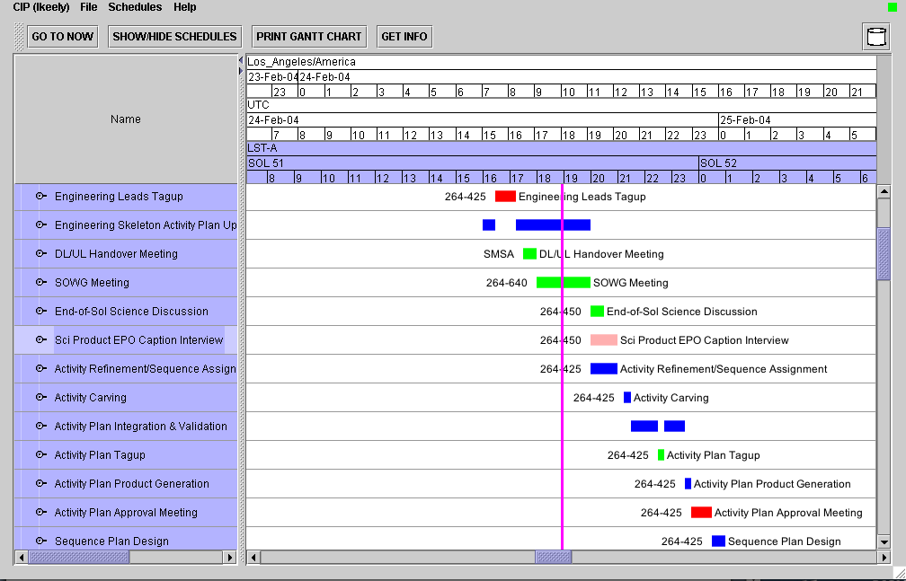
Schedule Viewer
Schedule update indicator
Multiple time scales
Unified schedules
“Now” bar

Slide 13
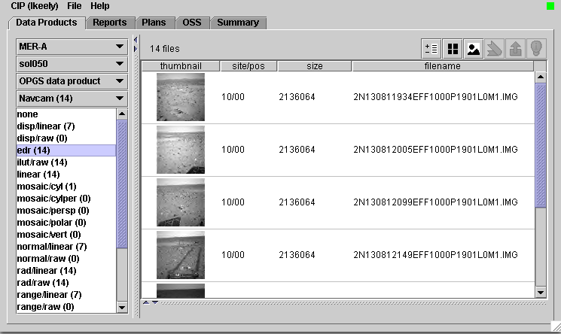
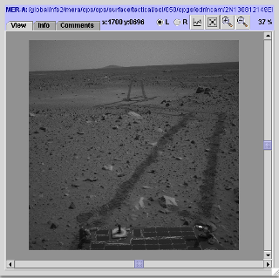
Data Product Navigator

Slide 14
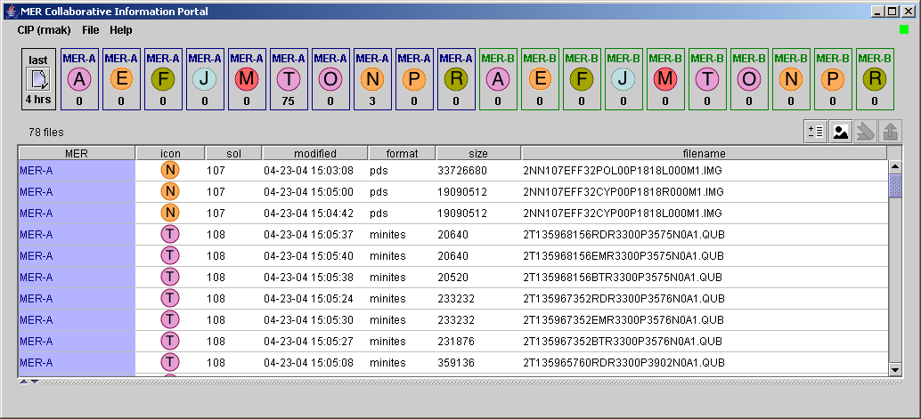
New File Notification
Duration
Icons
Files

Slide 15
Three–Tiered Enterprise Architecture
Client
Java application (Swing)
Middleware Server
Web services, Enterprise JavaBeans (EJB), Java Message Service (JMS)
Service-oriented architecture (SOA)
Data Repository
Mission file servers (Unix)
File monitor (Java application)
Data loader (Java application)
Database (Oracle)

Slide 16
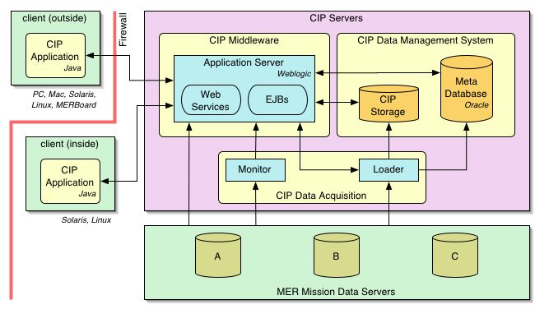
Architecture Overview

Slide 17
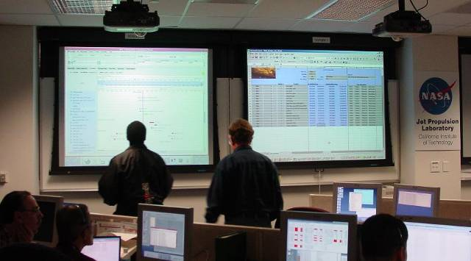
CIP Middleware Services
User management
Metadata
Schedules
Mars and Earth time
File and directory
Message
Mission Control Center, JPL

Slide 18
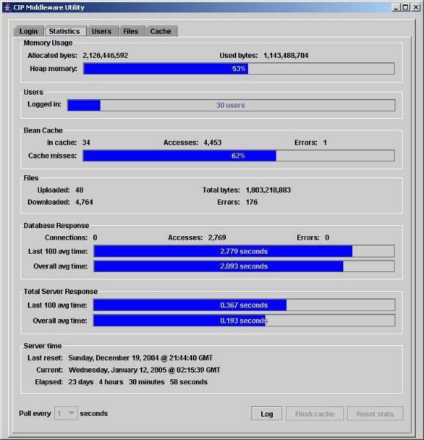
Middleware Monitor Utility
Server statistics

Slide 19
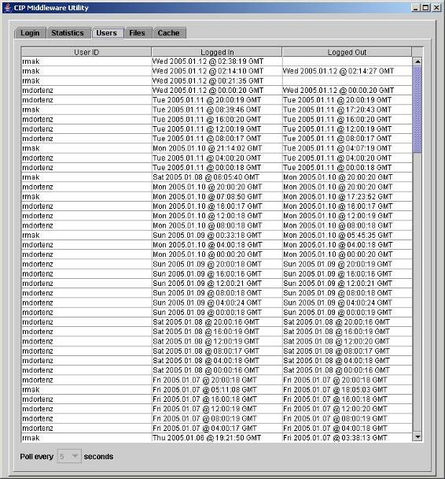
Middleware Monitor Utility
Users

Slide 20
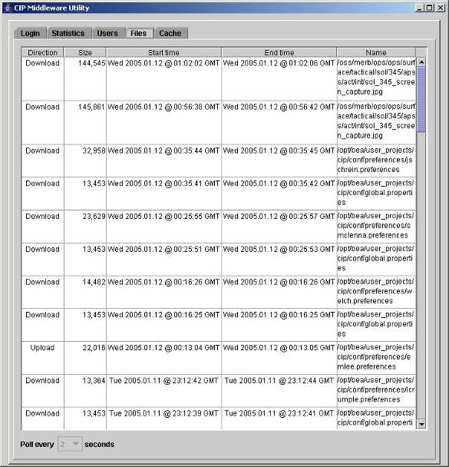
Middleware Monitor Utility
Files uploaded or downloaded

Slide 21
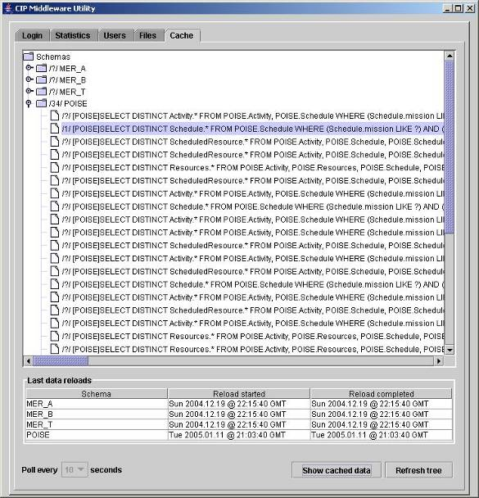
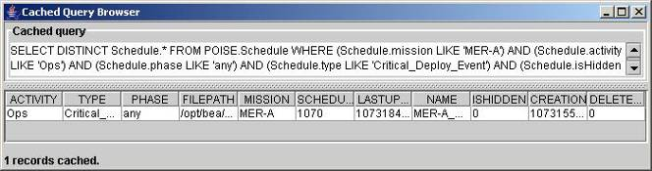
Middleware Monitor Utility
Cache contents

Slide 22
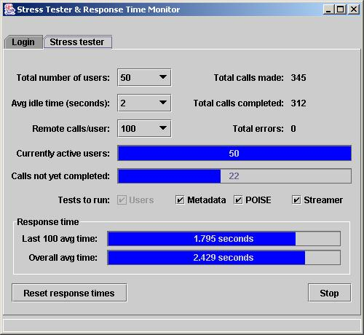
Middleware Stress Tester
Simulate multiple users performing client operations simultaneously.
Can the server handle a heavy load?
What is its behavior when it starts to fail?

Slide 23

CIP Summary
Provided situational awareness for MER mission personnel
Download images, data, schedules, current time
Collaboration
Alerts
Service-oriented architecture (SOA)
Java Swing and C++ desktop client applications
J2EE technologies
Web services
Mission file servers
Metadatabase
BEA WebLogic, Oracle RDBMS
Open source software
Wind-sculpted sand patterns on Mars

Slide 24
Case Study 2: The Systems Health Information Portal (SHIP)

Slide 25
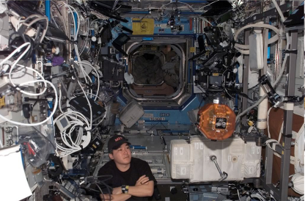

Case Study 2: The Systems Health Information Portal
The Systems Health Information Portal (SHIP) constantly monitors and analyzes sensor data gathered from a manned NASA space vehicle.
If there is a fault with the vehicle, SHIP quickly analyzes the situation and recommends corrective actions for the astronauts on board, even if contact with ground control is lost.
Life on board the International Space Station
My role: Project Scientist University of California at Santa Cruz
Architect, lead developer, and systems integrator, 2004-2005

Slide 26
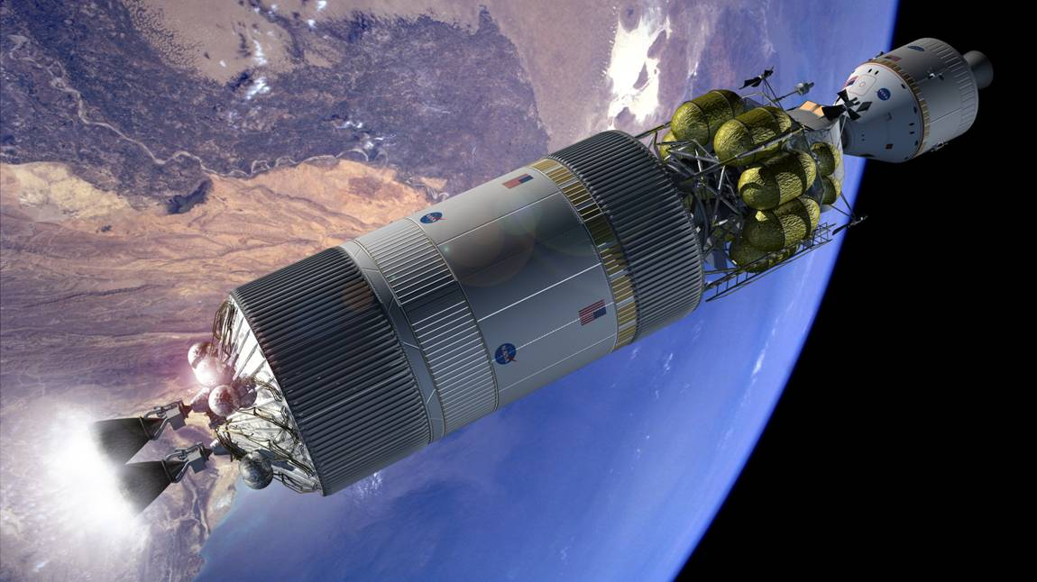
SHIP Requirements
Access to disparate data sources
Databases, files, live instrument streams, web services, web pages, programs
Multiple data formats
Relational tables
XML, text, and binary files
Proprietary and legacy data formats
Generate and manage reports
Fault analyses
Prognostications
Procedure manuals
Test bed
International Space Station (ISS)
Rendezvous in low Earth orbit (LEO) of a
manned space capsule with the main rocket engines
in preparation for a trip to the Moon or to Mars.

Slide 27
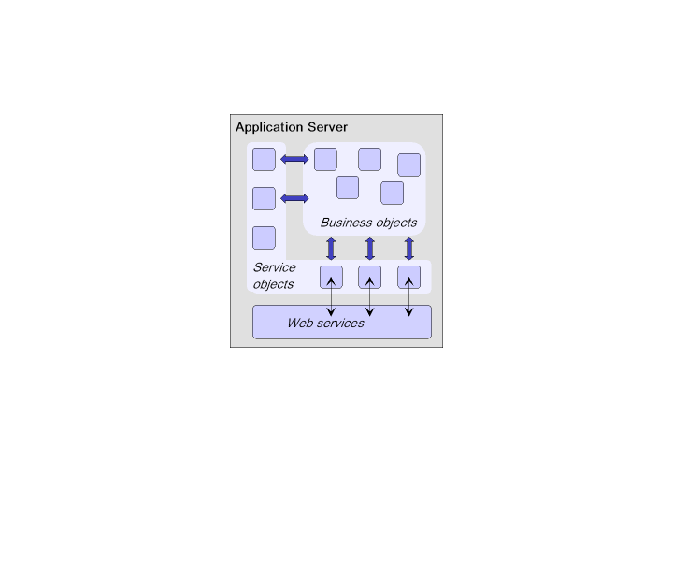
SHIP Architecture

Slide 28
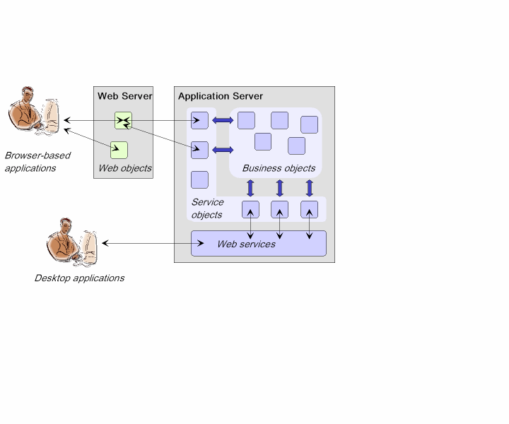
SHIP Architecture

Slide 29
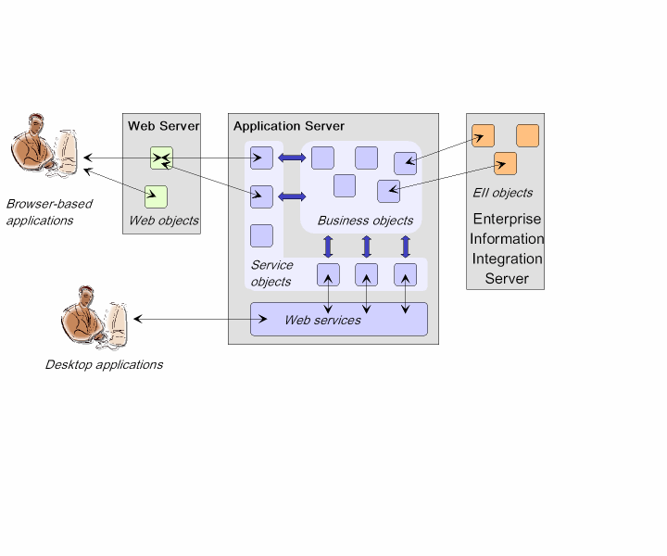
SHIP Architecture

Slide 30
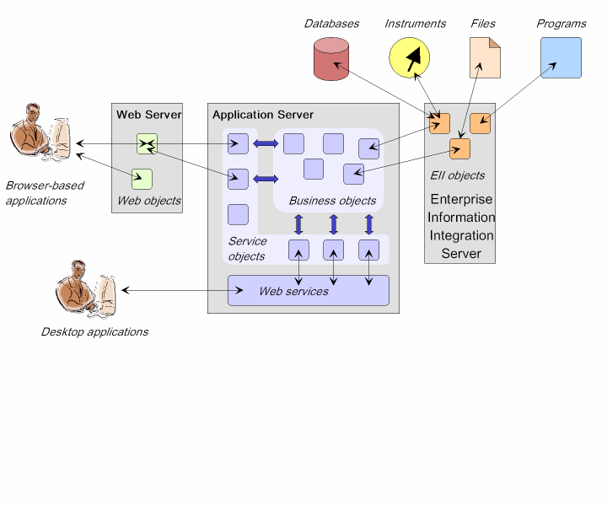
SHIP Architecture
Matching
Engine
Case base

Slide 31
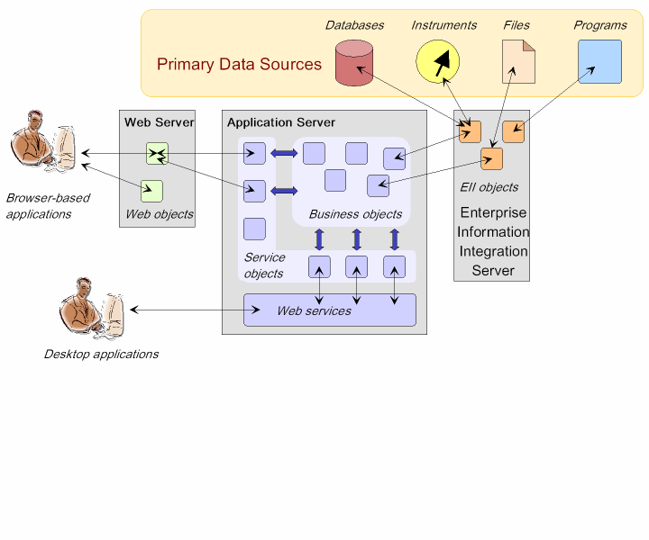
SHIP Architecture
Matching
Engine
Case-Based
Reasoning
Case base

Slide 32
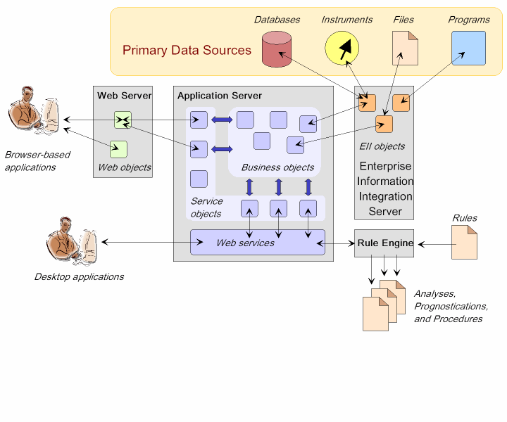
SHIP Architecture
Matching
Engine
Case-Based
Reasoning
Case base

Slide 33
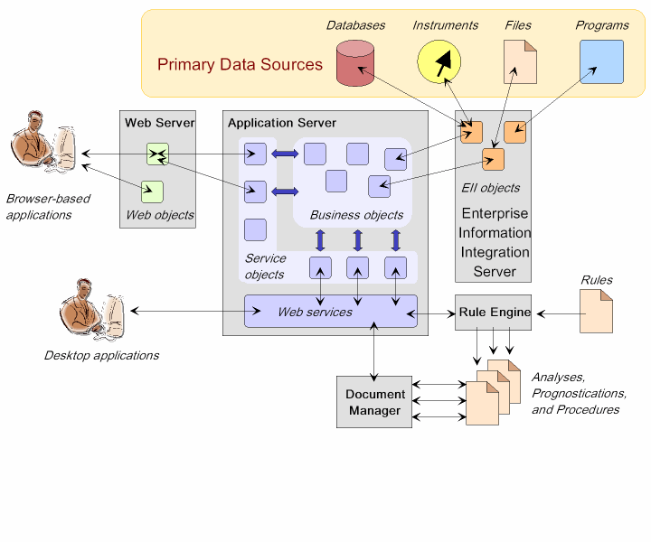
SHIP Architecture
Matching
Engine
Case-Based
Reasoning
Case base

Slide 34
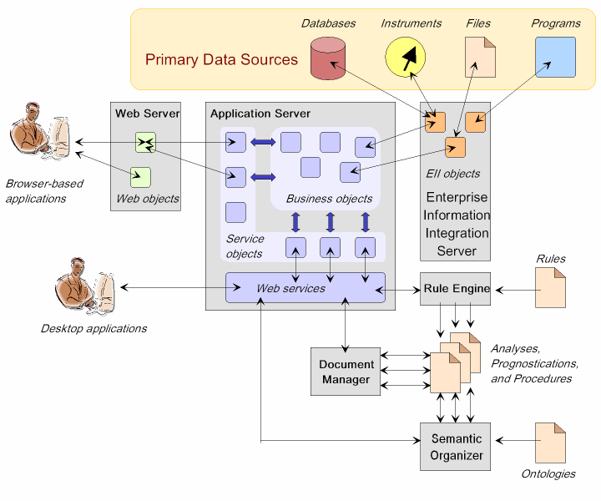
SHIP Architecture
Matching
Engine
Case-Based
Reasoning
Case base

Slide 35
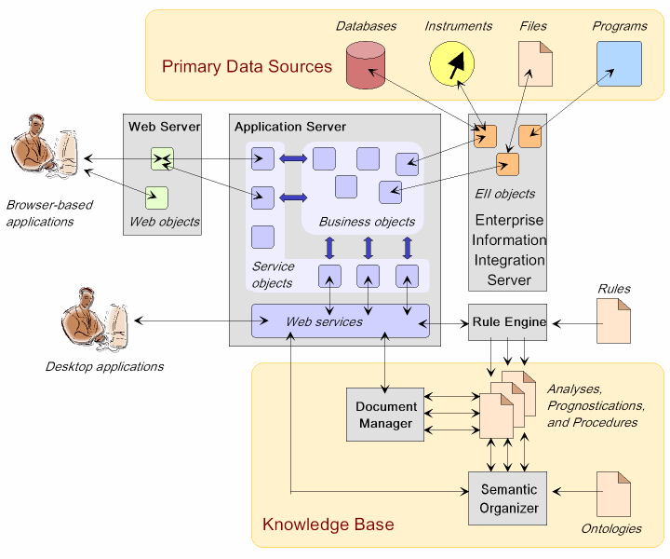
SHIP Architecture
Matching
Engine
Case-Based
Reasoning
Case base
Raw data
➔ Integrated information
➔ Analysis
➔ Knowledge
➔ Action

Slide 36
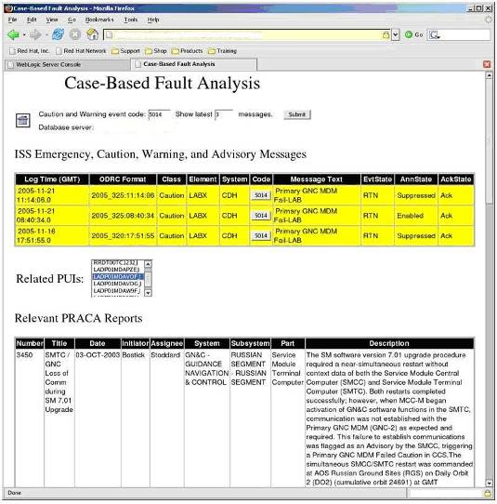
SHIP Screen Shot
ISS International Space Station
PUI Program Unique Identifier (part number)
PRACA Problem Report and Corrective Action

Slide 37
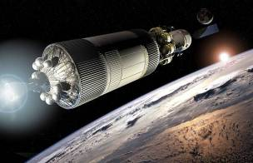
SHIP Summary
Problem Resolution and Corrective Action (PRACA) system for manned space vehicles
Disparate data sources: live sensor feeds, archived legacy data, XML files, Word documents, web pages, web services, databases, etc.
Case-based reasoning and rules-based diagnoses
Semantics-based knowledge management
Service-oriented architecture (SOA)
Web-based and desktop client applications
J2EE technologies
Web services
Enterprise information integration (EII)
Application integration
JavaServer Faces, BEA WebLogic, Composite Software
Open source software

Slide 38
Case Study 3: Shot Data Management

Slide 39
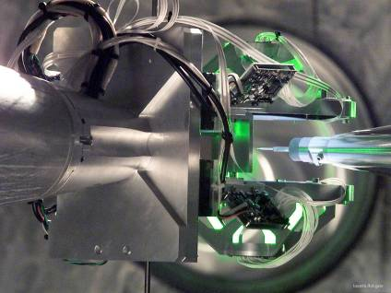


Case Study 3: Shot Data Management
The National Ignition Facility (NIF) is a major laser-based fusion energy research project at the Lawrence Livermore National Laboratory.
Each simultaneous firing of its 192 powerful lasers at a BB-sized target generates gigabytes of data that Shot Data Management routes in near real time to the project scientists and researchers.
Target positioner
My role: Enterprise Software Strategist
Architect, catalyst, lead developer, and systems integrator, 2006-2007
High security clearance (Level P)

Slide 40

Shot Data Management Primary Services
Data provisioning
Integration of disparate and heterogeneous data sources
Secure access and downloads
Metadata-based queries
Data management
Version management and revision control
Archive data from NIF’s expected 30-year lifespan
Data marts
Historical and trend analysis of specific subject areas
Support ad hoc data reporting
The target: A polished 2 mm capsule
filled with cryogenic hydrogen fuel.

Slide 41
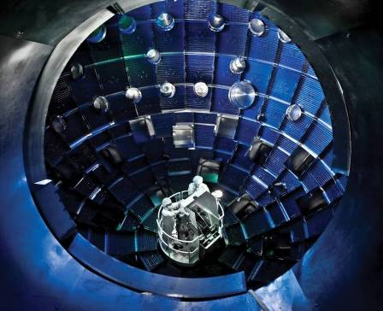
Requirements
Application insulation
Eliminate duplicate data
Near real time data access
Reusable data services
Decision support
Quality control
Hierarchical storage management
Data security
Integrate legacy data silos
Workflow management
NIF target chamber

Slide 42
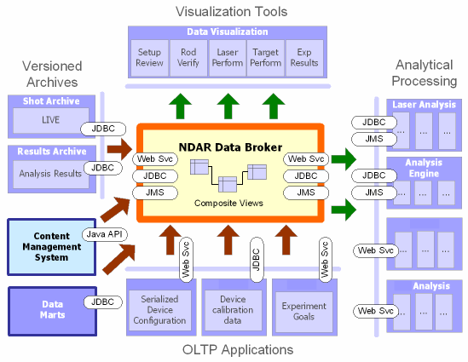
Architecture Overview
Industry standards
Web services
XML data sources
JDBC and ODBC (database interfaces)
Java Message Service (JMS)
BPEL (Business Process Execution Language)
Java programming language
SOA (Service-Oriented Architecture)
Linux server clusters
Oracle RDBMS
Oracle CMS (Content Management System)

Slide 43
Shot Data Management Architecture

Slide 44
Workflow: Set Up Campaign & Approve Experiment
Generate service order
Create campaign
Execute
Service
Order
Set Up
Campaign &
Experiments
Approve
Experiment
Export to ICCS
Generate
Settings
Diagnostic
Configuration
Approved
Settings
Run
Expert Group
Tools

Slide 45
Workflow: Manage Configuration & Calibration
Request calibration
Service Order
Calibrate
Data
Diagnostic
Calibration
Calibrate
Install
Diagnostic
Configuration

Slide 46
Workflow: Analyze & Visualize Shot Results
Request shot report
Render &
Publish
Report
Diagnostic
Calibration
Diagnostic
Configuration
Brokered
Data
Archive
Results
Analyze
Shot Data
Laser Diagnostics
Target Diagnostics
Optics Inspection
Raw
Data
“Data Ready”
Events

Slide 47
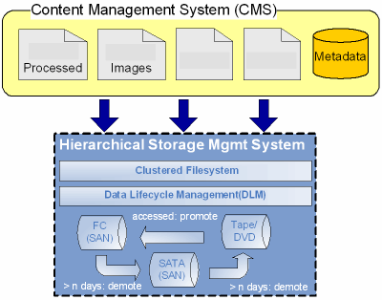
Data Archiving
Hierarchical storage management system

Slide 48
Visualizing Workflows
Large display of many nodes in multiple “swim lanes”
Each node represents a unit of work to be performed.
Each swim lane represents a category of work.
Results flow from one node to the next based on rules.
The display is maintained in real time.
Currently active nodes are highlighted.

Slide 49
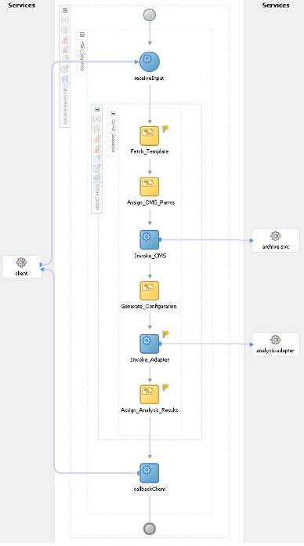
Creating a Workflow
Create workflow diagrams using an IDE.
Compile workflow diagrams into BPEL scripts.
Business Process Execution Language (XML)

Slide 50
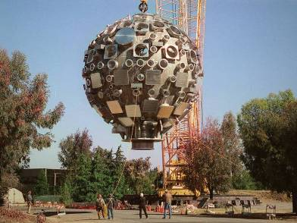
Shot Data Management Summary
Large, complex distributed system based on SOA
Integration of legacy data silos
data warehouses
relational databases
content managers
Data archiving
HSM
30 years of data
Workflows
Shot approval and setup
Configuration and calibration
Results analysis and visualization
Installation of the target chamber
“This system saved 6 months off the software development schedule.”

Slide 51

Case Study 4: SPLASH A Platform for Integrating Heterogeneous Simulation Models
Research Staff Member
IBM Almaden Research Center

Slide 52
What is SPLASH?
SPLASH is
Smarter Planet Platform for
Analysis and Simulation of Health
But we’re not going to talk about any of that just yet ...

Slide 53
Can We Make Complex Decisions …
… about really hard problems
using computers and software
in ways that leverage IBM’s unique strengths?
powerful processors
cloud computing
data integration
analytics
services

Slide 54
What Can Make a Problem Really Hard?
It involves math
It involves people
It has many parts
No one can understand all the parts at once
Not everyone agrees what the problem is

Slide 55
Divide and Conquer!
Break a hard problem into smaller parts
Assign an expert to each part
Each expert makes decisions about his or her part of the problem
Put all the decisions together
Is this the way to make decisions about really hard problems?

Slide 56
Obesity
It’s an example of a REALLY hard problem in healthcare
Divide and conquer:
Eat less!
Exercise more!
Obesity
Eat less!
Exercise more!
What’s to decide?

Slide 57
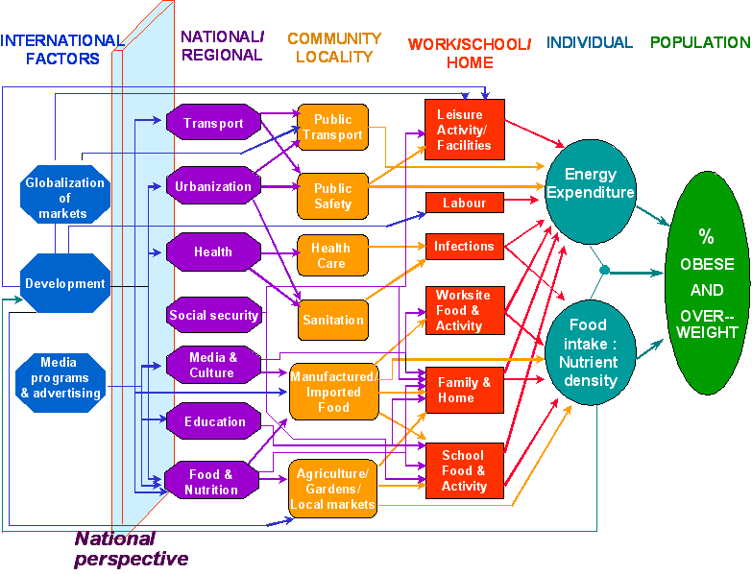
It’s not that simple …
Lots of components, all interrelated!

Slide 58
Hire More Experts!
Nutrition experts
Exercise experts
Transportation experts
City planning experts
Public safety experts
Education experts
Family guidance experts
Media experts
Government policy experts
Management experts
Legal experts
Financial experts
…
HELP!

Slide 59
Problems with Experts
Each expert works within his or her own domain of expertise
Decision silos
They don’t talk to each other
Each domain has its own language and vocabulary
Expert A’s decisions don’t agree with Expert B’s decisions
Nobody sees the Big Picture

Slide 60
Unintended Consequences
Find a neighborhood where obesity is a major problem
Decide to replace the local store that sells bad, unhealthy food with one that sells good, healthy food
Hooray! The store becomes popular and everyone wants to shop there
Their average BMI (body mass index) decreases
The store gets too busy and crowded
Instead of walking to the store, people get into their cars and drive to a bad, unhealthy store over in the next neighborhood
Neighborhood residents return to eating bad food
Now they exercise less than previously
Their average BMI increases to higher than what is was before

Slide 61
Multi-Level, End-to-End Modeling
Socio-Economic Models
4
Business Models
3
Healthcare Ecosystem
(Society)
5
System Structure
(Organizations)
Lever1
Lever2
Lever3
2
Policy “Flight Simulator”
Careflow Models
(Flow of Patients, Money, Information)
Delivery Operations
(Processes)
1
6
Clinical Practices
(People)
Personalized Medicine
(Targeted interventions)
Disease Progression Models
Rouse, W. B. & Cortese, D. A. (2010). Introduction, in W. B. Rouse & D. A. Cortese (Eds.), Engineering the System of Healthcare Delivery. IOS Press.
Notes:
Rouse, W. B. & Cortese, D. A. (2010). Introduction, in W. B. Rouse & D. A. Cortese (Eds.), Engineering the System of Healthcare Delivery. IOS Press.

Slide 62




The SPLASH Platform
Metadata - Model inputs and outputs - Access and execution - Data schemas - Model and data locations - Model and data semantics
SPLASH REPOSITORY
contains
Provide models and data
SPLASH MODULES
Model and Data Registration
Model, Data, and Mapping Discovery
describes
Use models and data
Model and Data Composition
Model
Data
Experiment Manager
Composite Model
Model Execution
Model
Collaborative Reporting and Visualization
Data
Mapping
Multi-disciplinary users

Slide 63
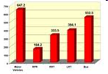
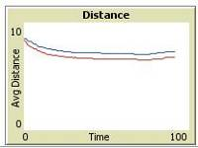
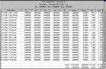
Hypothetical Obesity Model Integration
GIS data
Transportation
(VISUM simulation model)
Geospatial
alignment
Buying and Eating
(Agent-based simulation model)
Demographic data
Time alignment
and data merge
Exercise
(Stochastic discrete-event simulation model)
Facility data
BMI
(Differential equation model)
Simulation model
Data source
Data Transformation
Dataflow

Slide 64
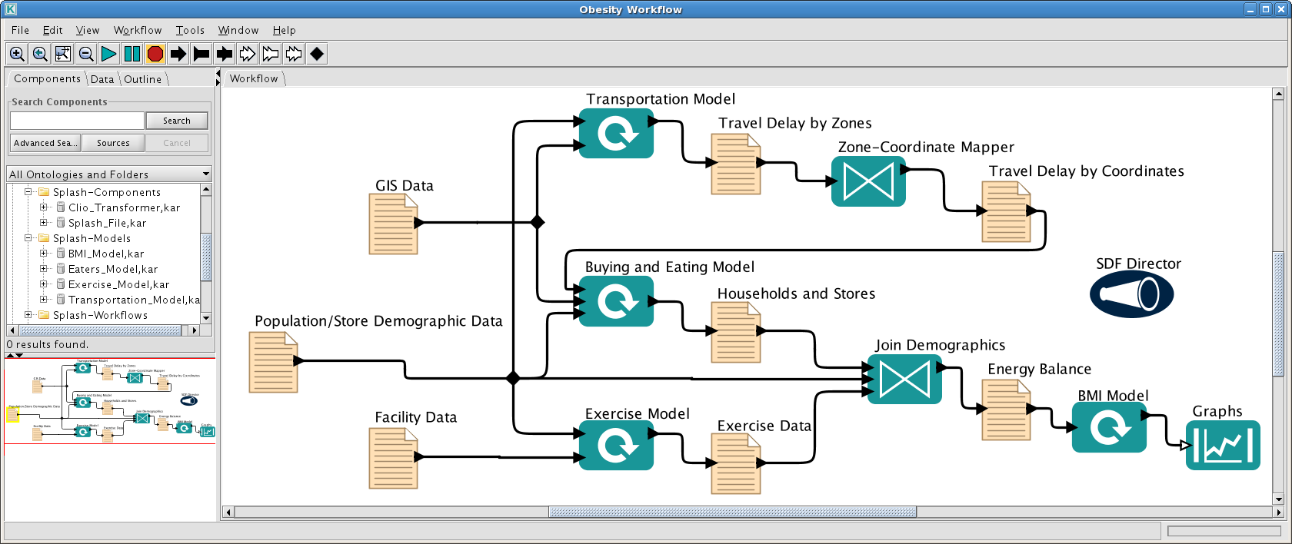
Model Integration as a Scientific Workflow
Obesity Workflow
Kepler Scientific Workflow System
Drag-and-drop graphical editor to design workflows
Automatically runs simulation models and data transformations
Extensible open-source software developed by U.C. Davis and U.C. Berkeley

Slide 65
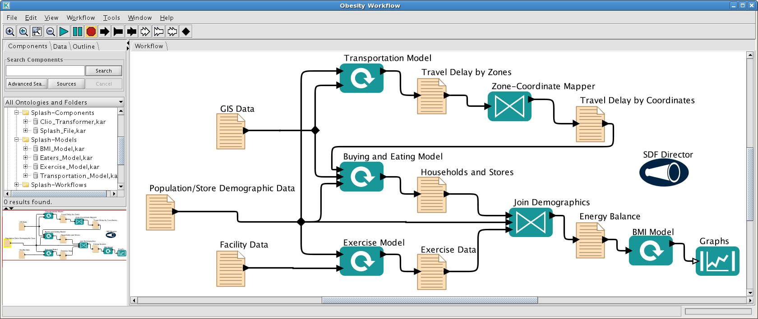
SPLASH Actors
Obesity Workflow
Model actor
Mapping actor
Data actor
Visualization actor
Data actors: input and output files, databases, web services, etc.
Model actors: simulation, optimization, statistical models
Mapping actors: data transformations, time and space alignment
Visualization actors: graphs, reports, etc.

Slide 66
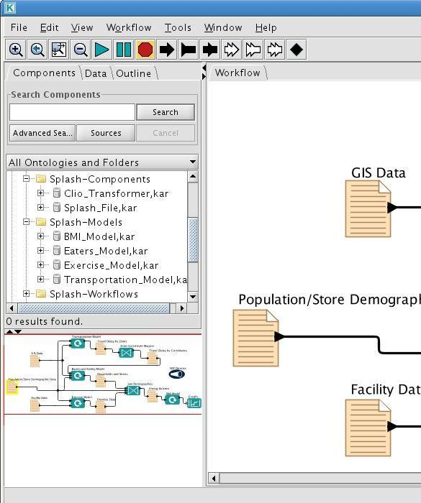
SPLASH Repository
Search the SPLASH repository for models and data that you can integrate into a meaningful workflow
Query the models and data based on their SADL descriptions
Drag and drop the model and data actors from the repository onto the workflow
Repository

Slide 67
Execution and Results
Obesity Workflow
Distributed, parallel execution
Run simulation models and data transformation scripts
Final results as reports and graphs for analysis

Slide 68
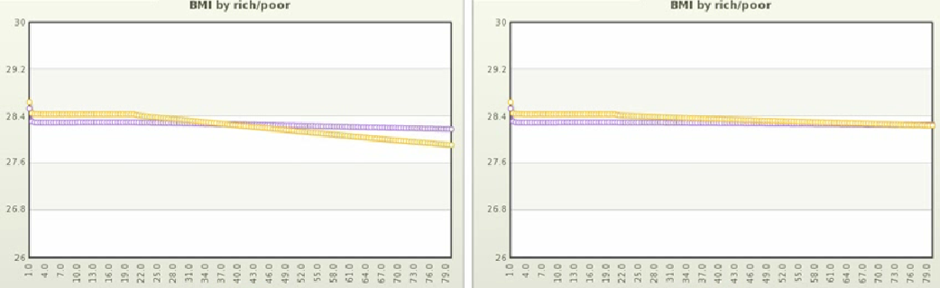
Sample Final Results
At tick 20: Open a new healthy foods store in a neighborhood.
BMI by rich/poor
BMI by rich/poor
rich poor
rich poor
Without traffic model
Including traffic model
* Many assumptions, sample only, your mileage may vary …
© 2011 IBM Corporation

Slide 69
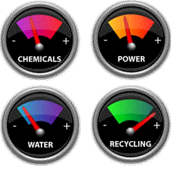
Experiment Management
Experiment design (“what if”)
Execute a workflow multiple times
Vary the operating parameters of the models
Replace models
Change the data sets
“Dashboard” of model parameter values
Analyze changes in the final results
Sensitivity analysis and root cause analysis
Data provenance
What inputs produced a given set of outputs?
Verification
Do results match with empirical data (reality)?

Slide 70
It’s All about Collaboration
The SPLASH platform brings domain experts together
Each expert contributes a model for the integration
Designing workflows forces system-level thinking
No decision silos!
SPLASH provides a common platform
Experts can talk to each other!
Discover new insights into a really hard problem
What models do we need for the workflow?
What experiments should we run?
How does changing a model’s input affect the final result?
Make better-informed policy decisions.

